Slide 1


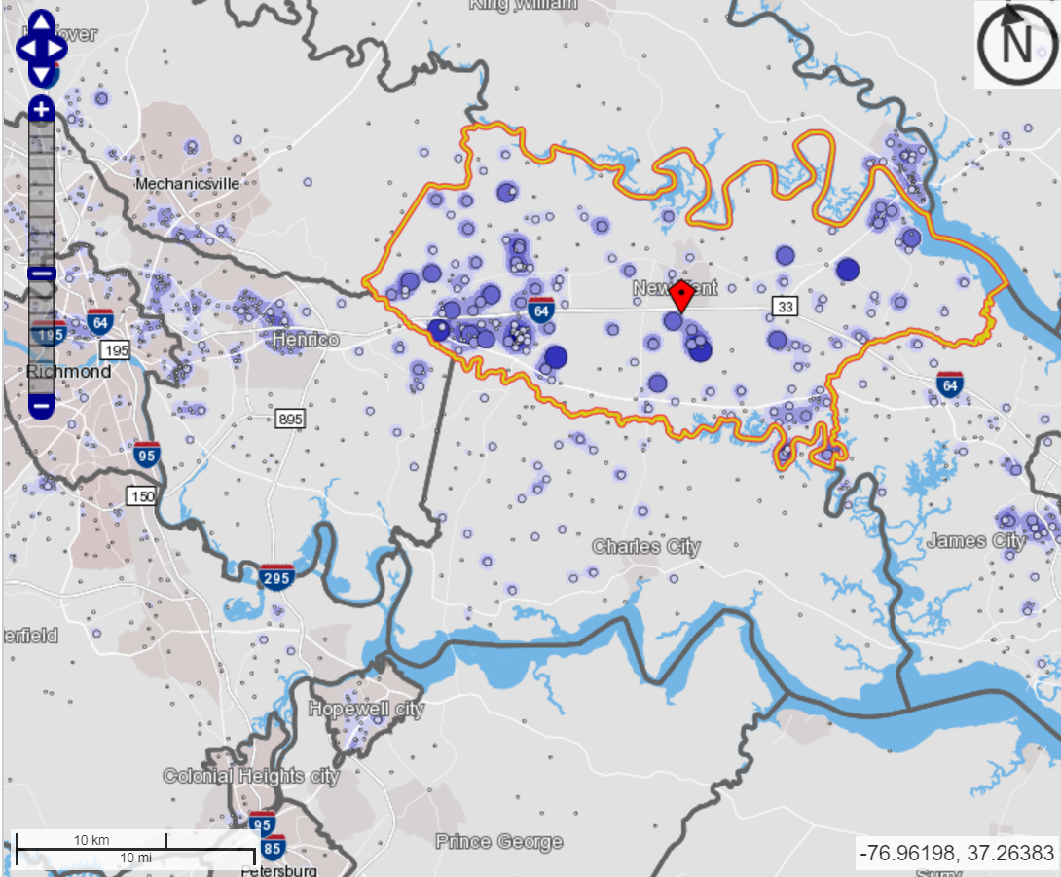
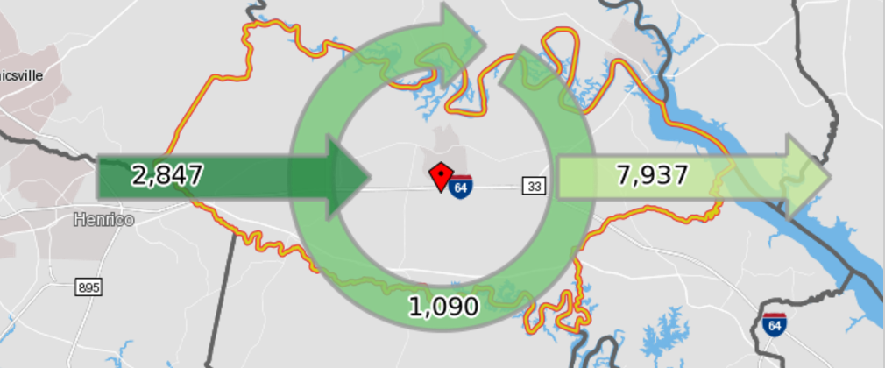
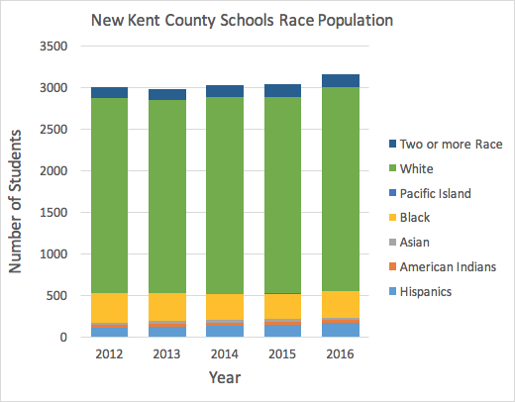

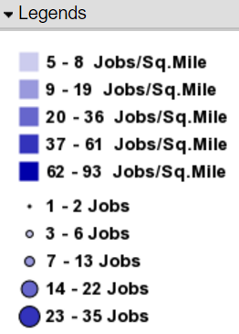
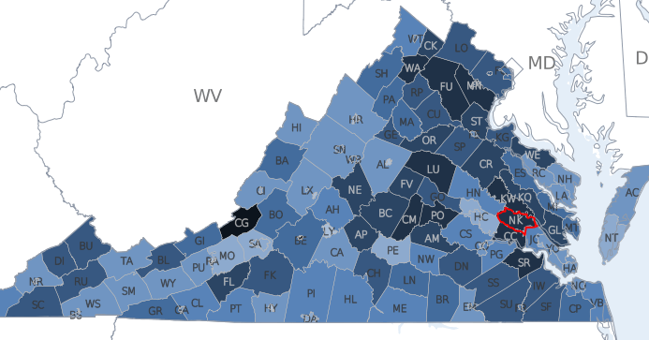
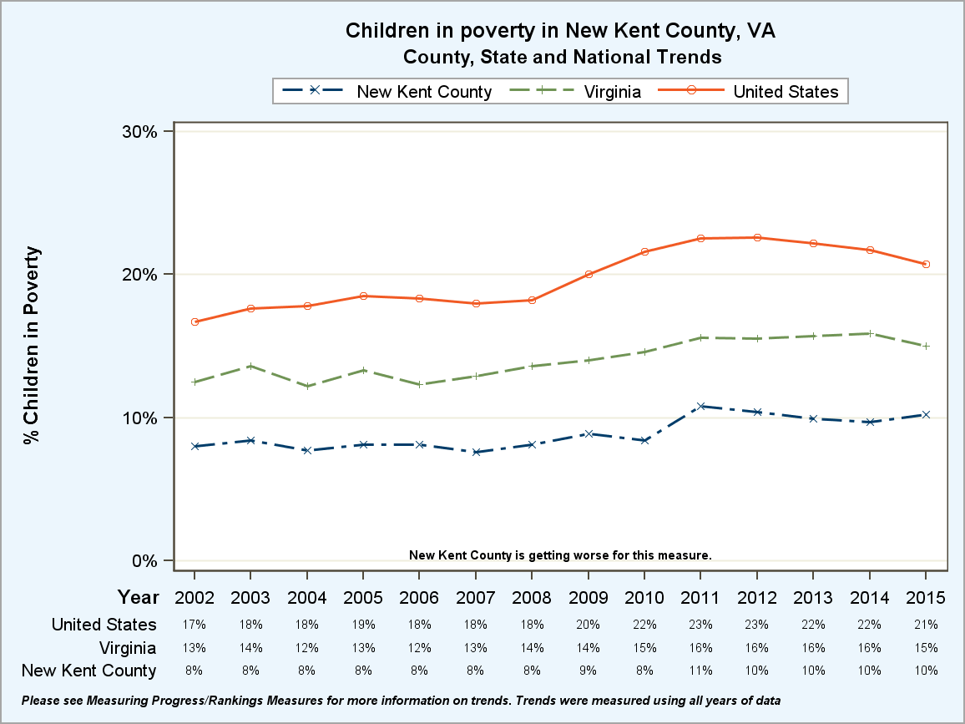
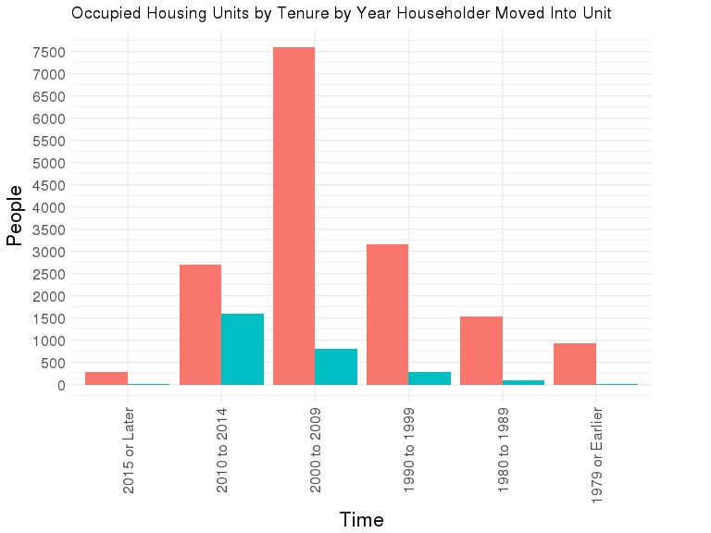

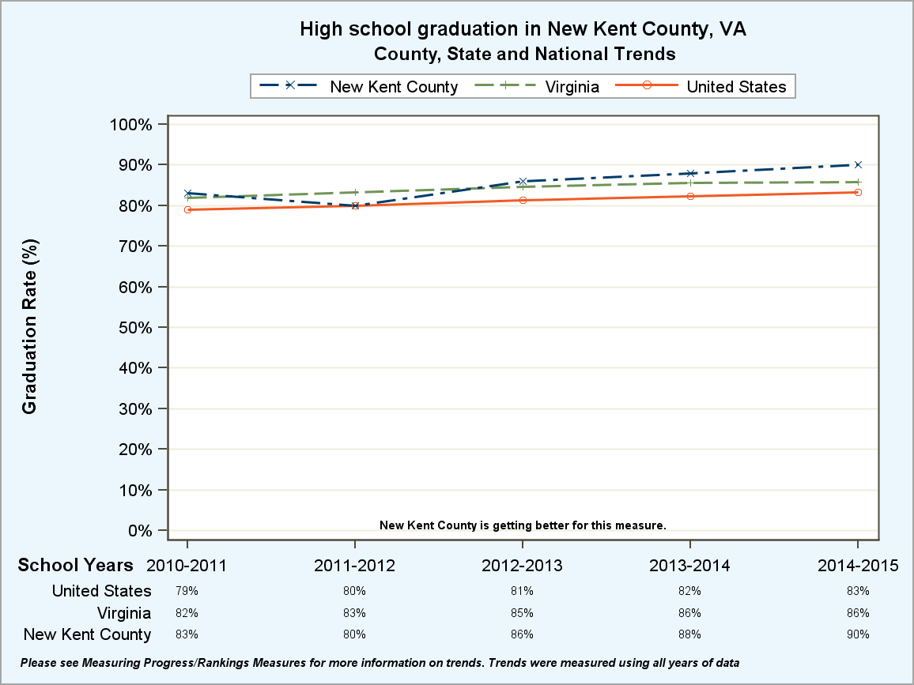


Profile of New Kent, VA
David Park, Joseph Kim, David Hinkle, Lata Kodali (Virginia Tech) with Dave Higdon and Stephanie Shipp (SDAL) Sponsor: Carl Frick, Virginia Corporate Extension (VCE) representative
Project Overview
New Kent Description
Problem: New Kent County officials are worried about their youth and lack of afterschool activities. Some parents have long work commutes, and there is a concern about increased drug usage. Another issue is the lack of transportation for programs such as 4-H and other barriers to enrollment in 4-H, such as cost.
Plan: Use data from various sources to understand the issues of New Kent and how New Kent County compares to rest of Virginia.
5th fastest growing county in Virginia²
New Kent County is located in the eastern part the Commonwealth of Virginia founded in 1654.³
Area: 212 square miles of land and water
Population: 20,021⁴ (2014)
Unemployment rate: 3.8% versus Virginia 3.3% versus US 4.4%⁴ (2017)
Average income: New Kent $73,041 versus Virginia $65,015 versus U.S. $53,889⁴ (2011-2015)
Known for its recreational activities including hunting, fishing, boating, nature trails, golf, team sports, and pari-mutuel horse racing.
Data
County Health Rankings and Roadmaps
Virginia Community Profile for New Kent County
American Community Survey (ACS)
Virginia Department of Education
OnTheMap
Team New Kent visit to 4-H Camp field trip (June 28-29, 2017)
Transportation
School Population by Race, 2012-2016
Commute Heatmap⁶ (below):
61% of New Kent residents have at least a 30 minute commute compared to 38% for Virginia overall.
Bar graph⁷ shows the counts by race and rate of growth of school enrollment during 2012-2016.
There is a slight increase (5%) in overall school enrollment in New Kent between 20012 and 2016.
New Kent compared to Virginia 2016 (not shown in graph):
Commute Heatmap
Race | New Kent (2016) | Virginia (2016)
Two or more races | 5% | 5%
White | 78% | 50%
Pacific Islander | 0.06% | 0.15%
Black | 10% | 23%
Asian | 1% | 7%
American Indians | 1.2% | 0.27%
Hispanic | 5% | 15%
On the Map¹ (above): Map on left shows the location of jobs of New Kent residents. Many are traveling west to Richmond for work. Map on right shows more people leaving New Kent for work.
Growth in Housing
Socioeconomic Factors
The graph⁴ below shows the overall trend in growth of residents moving into the New Kent Area.
From 2000 to 2009, New Kent saw a huge overall growth in population by about 7,500 people.
The population increased 36.9% during this time span.
Children in Poverty and High School Graduation.⁶
On the left: Shows the rate of children in poverty in New Kent County from 2002-2015. New Kent has fewer children in poverty when compared to Virginia and the U.S.
Below: Shows the trend of high school graduation rate in New Kent County from 2010-2015. Compared to Virginia and the U.S, New Kent has a higher graduation rate.
Table⁴ below shows slight growth in households with children (~2%) and without children (~18%) in New Kent between 2005 - 2010 and 2011-2015 (ACS table B11005).
Household Type | Year | Estimate
With Children | 2005-2010 | 2261
With Children | 2011-2015 | 2300
Without Children | 2005-2010 | 4252
Without Children | 2011-2015 | 4999
Conclusion
New Kent is a small and fast growing county.
Many aspects of New Kent are positive: above average income, lower poverty rate, and high HS graduation rates when compared to Virginia averages
But some aspects are negative: employed residents have long commutes to work, there is concern that children have long unsupervised times after school, and fluctuating crime rates.
Risk Factors survey answered by 49 Cooperative Extension Agents
On the right: The word cluster from the survey shows that drugs, transportation, lack of resources, and poverty, are the biggest perceived issues in the county
Based on our analysis, it appears that some of these topics don’t appear to be a problem in New Kent, such as poverty among youth, but others are, such as lack of public transportation.
Year | Crime Rate per 100,000
2009 | 1724
2010 | 1633
2011 | 1544
2012 | 1886
2013 | 1204
2014 | 1675
2015 | 1720
Sources and References:
4. https://factfinder.census.gov/faces/tableservices/jsf/pages/productview.xhtml?src=CF
5. https://www.policymap.com/
6. http://www.countyhealthrankings.org/app/virginia/2017/rankings/new-kent/county
7. http://www.doe.virginia.gov/statistics_reports/enrollment/fall_membership/
https://onthemap.ces.census.gov/
http://yesnewkent.com/labor-market/growth/
http://www.co.new-kent.va.us/index.aspx?nid=89
Above: Crime Rate⁵ per 100,000 people in New Kent County includes crimes such as aggravated assault, burglary, murder, and rape. Majority crime type is burglary, and table indicates fluctuation in crime rate from 2009-2015. Currently, upward trend for New Kent.

